Slide 1

Unity 3D Essentials
Mobile Game Publishing
SoftUni Team
Technical trainers
Software University
https://softuni.org

Slide 2

Table of Contents
Google Play & App Store
Building for Google Play
Building for App Store
Google Play UI for managing & publishing
App Store UI for managing & publishing
Useful links

Slide 3
Have a Question?
sli.do
#Unity3D-Basics
Notes:
‹#›

Slide 4

Google Play & App Store

Slide 5
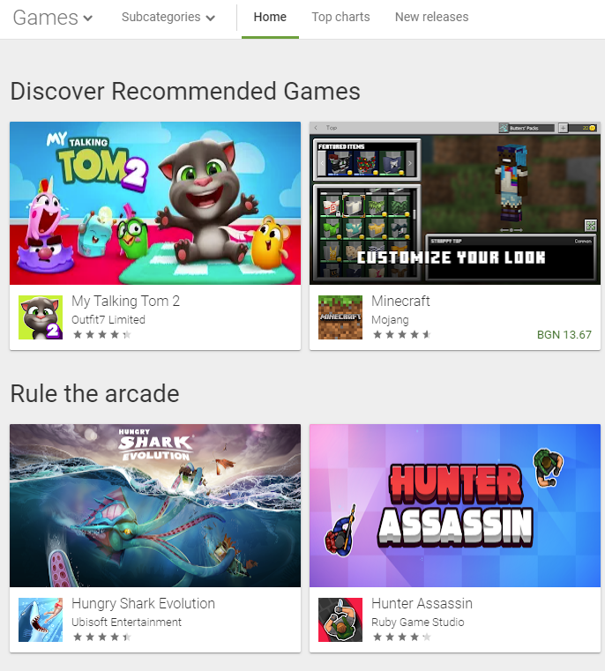
Google Play
One-time $25 fee
Easy review process
Tons of apps & games
Can do it from all OS
Pre-create the App/Game entry in the console

Slide 6
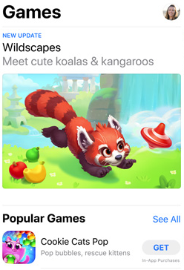
App Store
99$ yearly membership
Slow review process
Better experience apps
Must have MacOSX machine
Pre-create the app/game entry in the dev portal

Slide 7

Building for Google Play

Slide 8
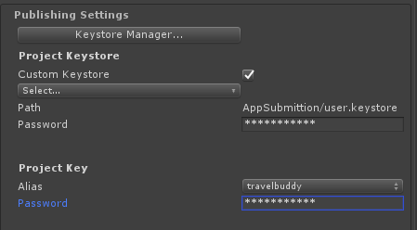
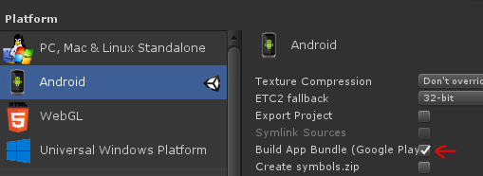
Overall steps
Ensure all is working
Set build to ABB
Set package name
Sign the build via the wizard
Always increase version on new build

Slide 9
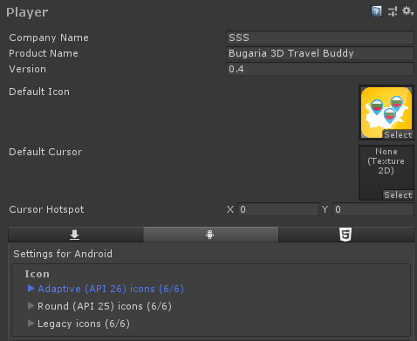
Good practices
Test on device before that (APK build)
Ensure FPS is above 45FPS
Save the signing info to a file
Set name and icons

Slide 10
Building for App Store

Slide 11
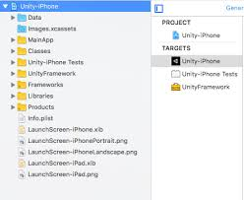
Overall steps
Ensure all is working
Use #If UNITY_IPHONE where needed
Set Provision Profile
Always increase version when building
Build
Open the XCode project
Ensure signing is ok
Build
Archive & Distribute (upload)

Slide 12
Good practices
Set up provision profiles etc in advance
Run on device after build (in Xcode)
Ensure FPS is ~60FPS
Set name and icons
Enter info if you are going to use Camera, GPS or Microphone
Do not make builds if you are not sure as approval takes time + the building process is way longer
There is alternatives to using MacOSX

Slide 13
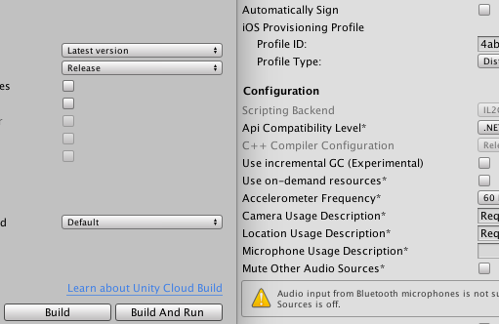
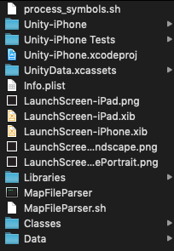
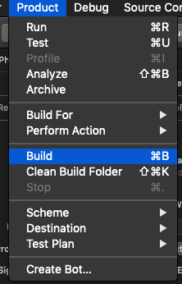
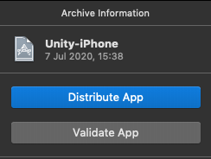
Visuals

Slide 14
Google Play UI for managing & publishing

Slide 15
Main steps
Add new app
Fill in screen shots & general description
Release Management -> App Releases
Each new APK/ABB/Version is new release
Roll out to production
Wait couple of days

Slide 16
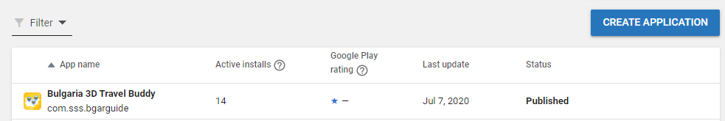
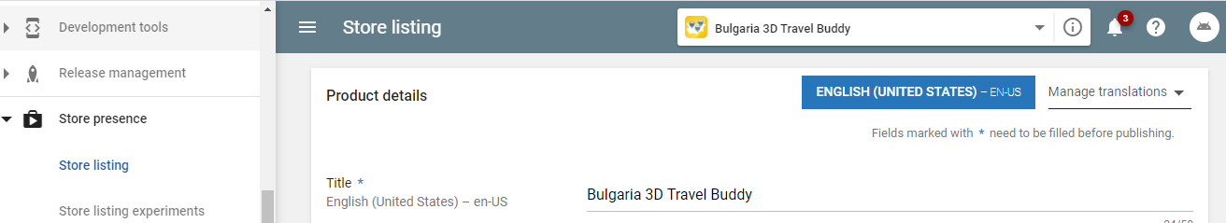
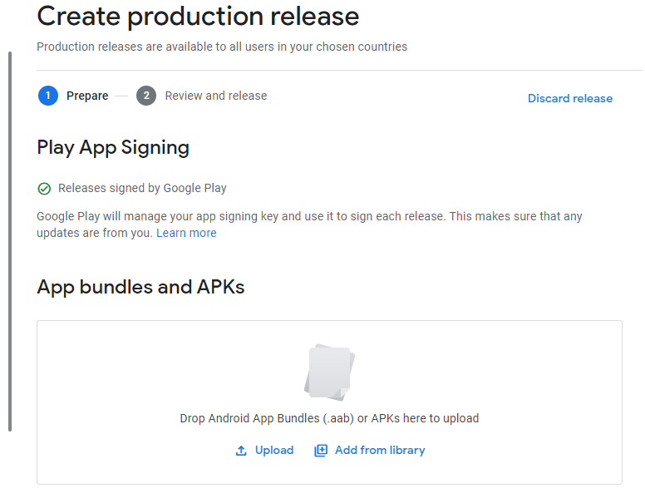
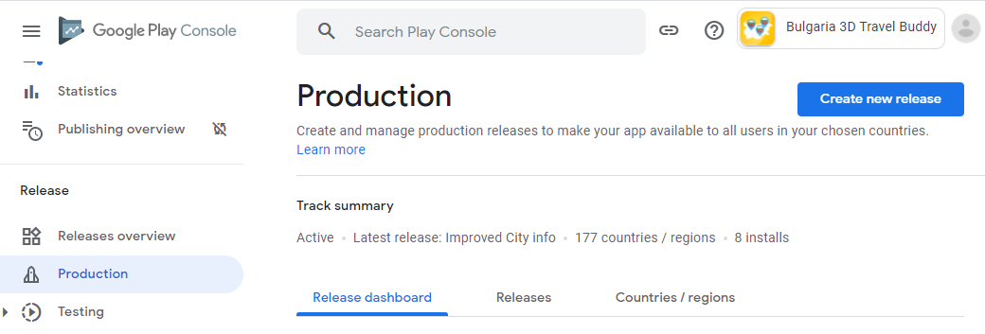
Visuals

Slide 17
App Store UI for managing & publishing

Slide 18
Main steps
Sign all contracts
Make sure all info for account is up to date
Create app
Fill in all screenshots and description
Build & Distribute(upload)
Check build status in Testflight section
Create new submission using the build

Slide 19
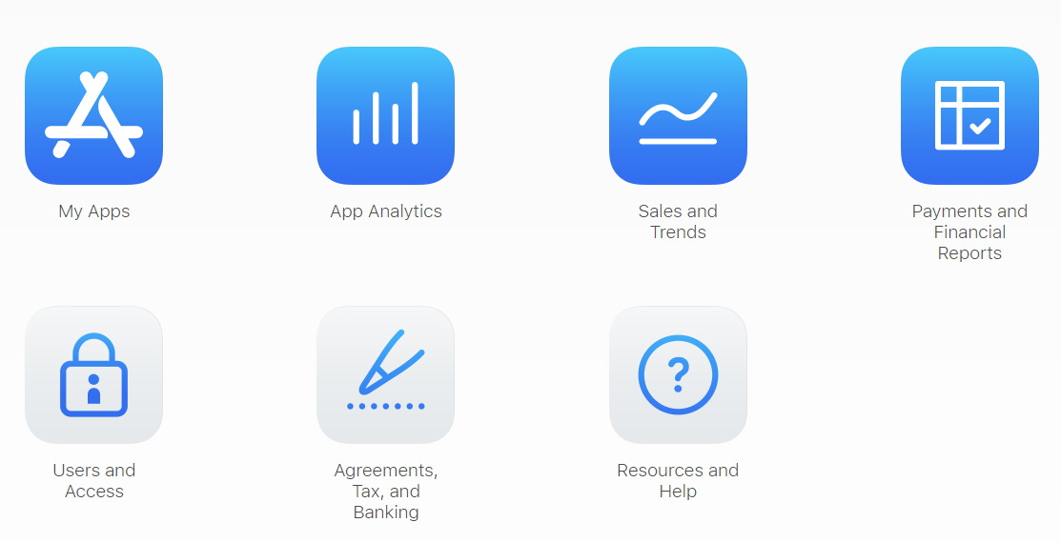
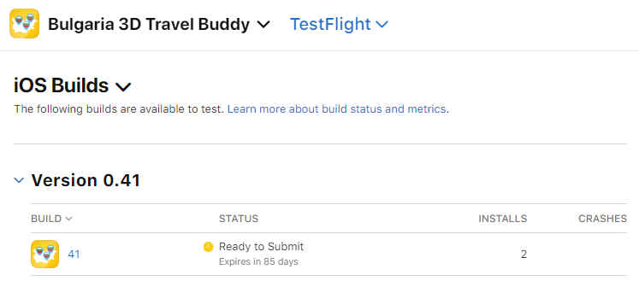
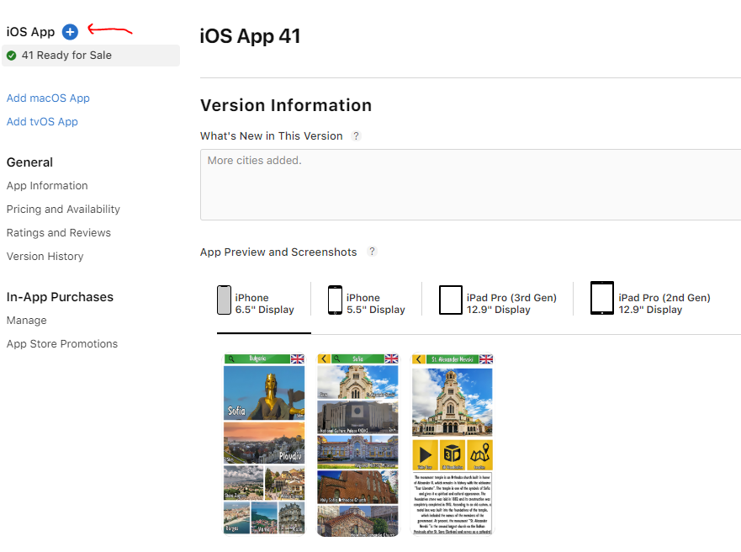
Visuals

Slide 20
Useful Links
https://appstoreconnect.apple.com/
https://play.google.com/apps/publish

Slide 21

Summary
Google Play & App Store
Building for Google Play
Building for App Store
Google Play UI for managing & publishing
App Store UI for managing & publishing
Useful links
Notes:
‹#›

Slide 22
Questions?
Email : dstrashilov@gmail.com
Notes:
‹#›

Slide 23

License
This course (slides, examples, demos, exercises, homework, documents, videos and other assets) is copyrighted content
Unauthorized copy, reproduction or use is illegal
© SoftUni – https://about.softuni.bg
© Software University – https://softuni.bg
Notes:
‹#›

Slide 24
Trainings @ Software University (SoftUni)
Software University – High-Quality Education, Profession and Job for Software Developers
about.softuni.bg, softuni.org
Software University Foundation
softuni.foundation
Software University @ Facebook
facebook.com/SoftwareUniversity
Software University Forums
forum.softuni.bg
Notes:
‹#›

